Slide 1
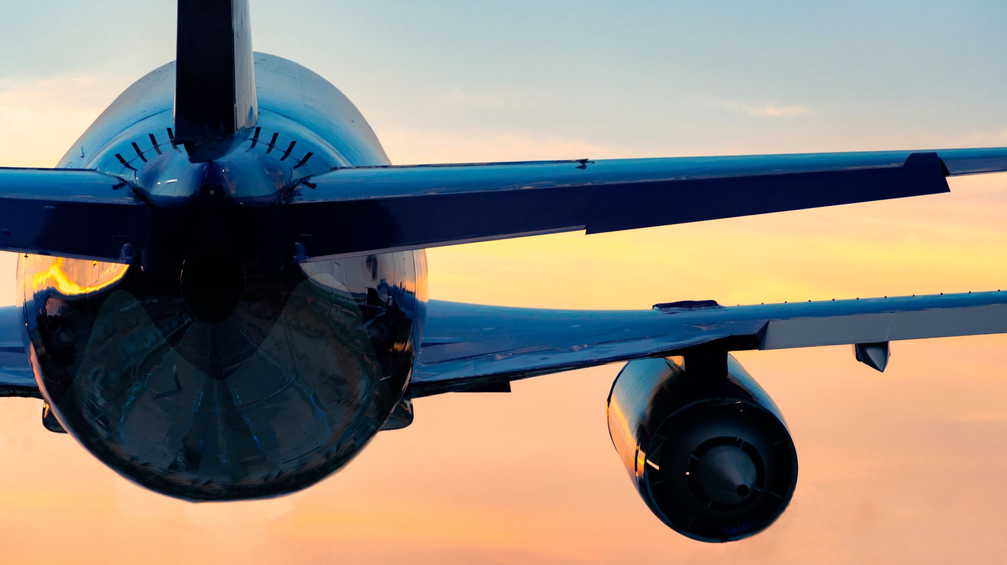
Airbus Quantum Computing Challenge （2019）
Bringing flight physics into the Quantum Era
https://www.airbus.com/en/innovation/disruptive-concepts/quantum-technologies/airbus-quantum-computing-challenge

Slide 2

5 Chanllenges
Aircraft Climb Optimization
Computational Fluid Dynamics (CFD) on Quantum Computers
Application of Quantum Computing to Surrogate Modeling of Partial Differential Equations
Wingbox Design Optimisation
Aircraft Loading Optimisation

Slide 3
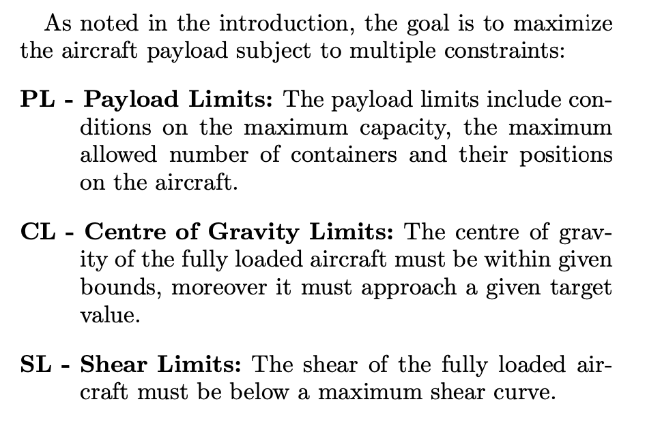
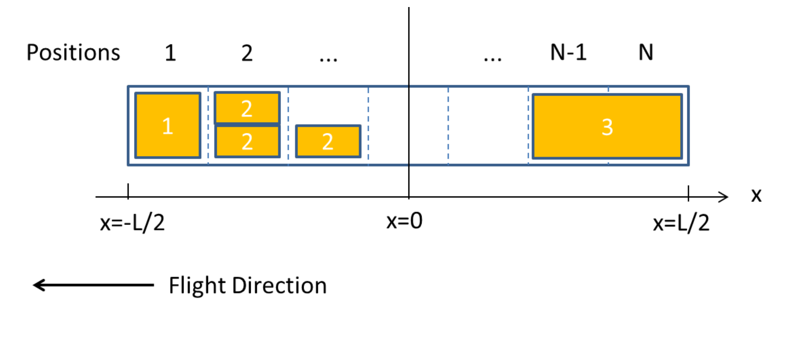
Aircraft Loading Optimisation

Slide 4

BMW Quantum Computing Challenge （2021）
Discover novel ways to help the automobile industry prepare for a future in which quantum computers could make a difference.
https://crowd-innovation.bmwgroup.com/servlet/hype/IMT?documentTableId=7025714350976950452&userAction=Browse&templateName=&documentId=740c3d47812c470b208a495d85f18206

Slide 5

4 Chanllenges
Sensor positions for automated driving functions: Accenture
Configuration optimisation of pre-series vehicles: 1QBit and NTT
Simulation of material deformations: Qu&Co
Automated quality analyses: QC Ware

Slide 6
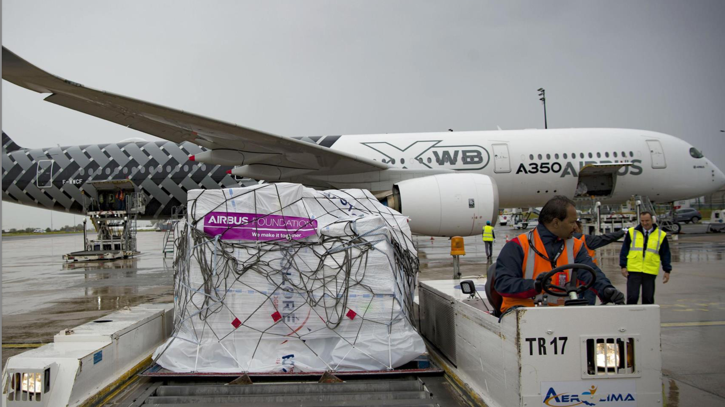
AIRBUS QUANTUM COMPUTING CHALLENGE
Aircraft Loading Optimisation
Yizhan Ao (Department of Computer Science, University of Maryland, College Park, MD 20742, USA)
Xiang Zhao (Institute for Quantum Computing, TuringQ, Shanghai 200241, China)
Zhixin Song (School of Physics, Georgia Institute of Technology, Atlanta, Georgia, 30332-0400, USA)

Slide 7
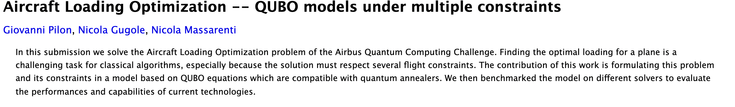
Winner
The Airbus Quantum Computing challenge has ended and the 2020 winner : the team Machine Learning Reply.

Slide 8
Contents
Following Machine Learning Reply’s paper, the constraints of the Aircraft Loading Optimization Challenge proposed by Airbus can be written in QUBO form, hence by treating them as penalty functions it is possible to assemble a QUBO model whose solution respects all the Aircraft Loading constraints.
We now present the results obtained with a classical tabu search solver for QUBO functions and with a Qiskit statevector simulator simulator accessed through API.

Slide 9
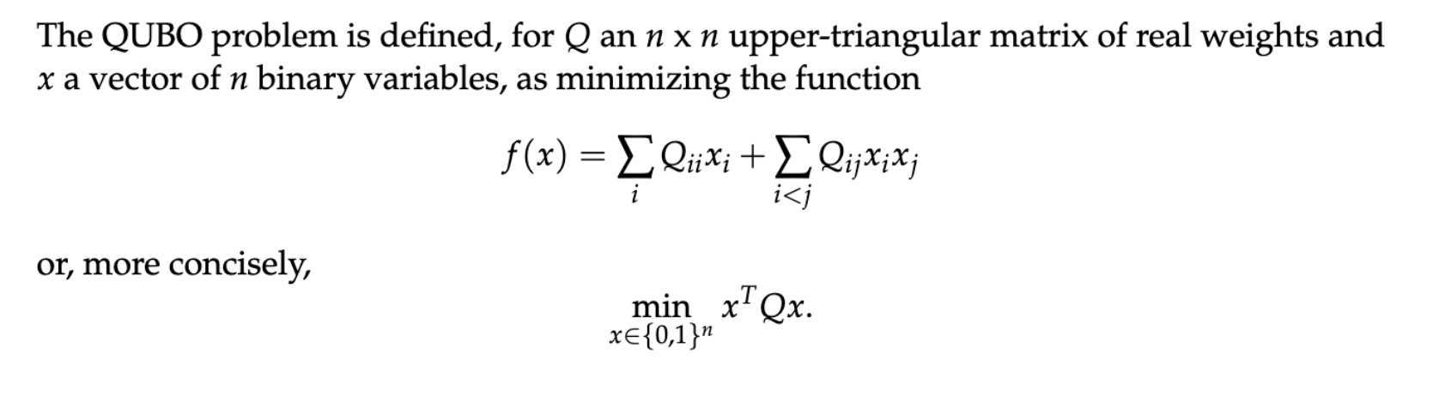
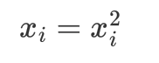
The Quadratic Unconstrained Binary Optimization Problem
In this case, the proper format of QUBO matrix is upper-triangular with linear terms included in the diagonal.

Slide 10
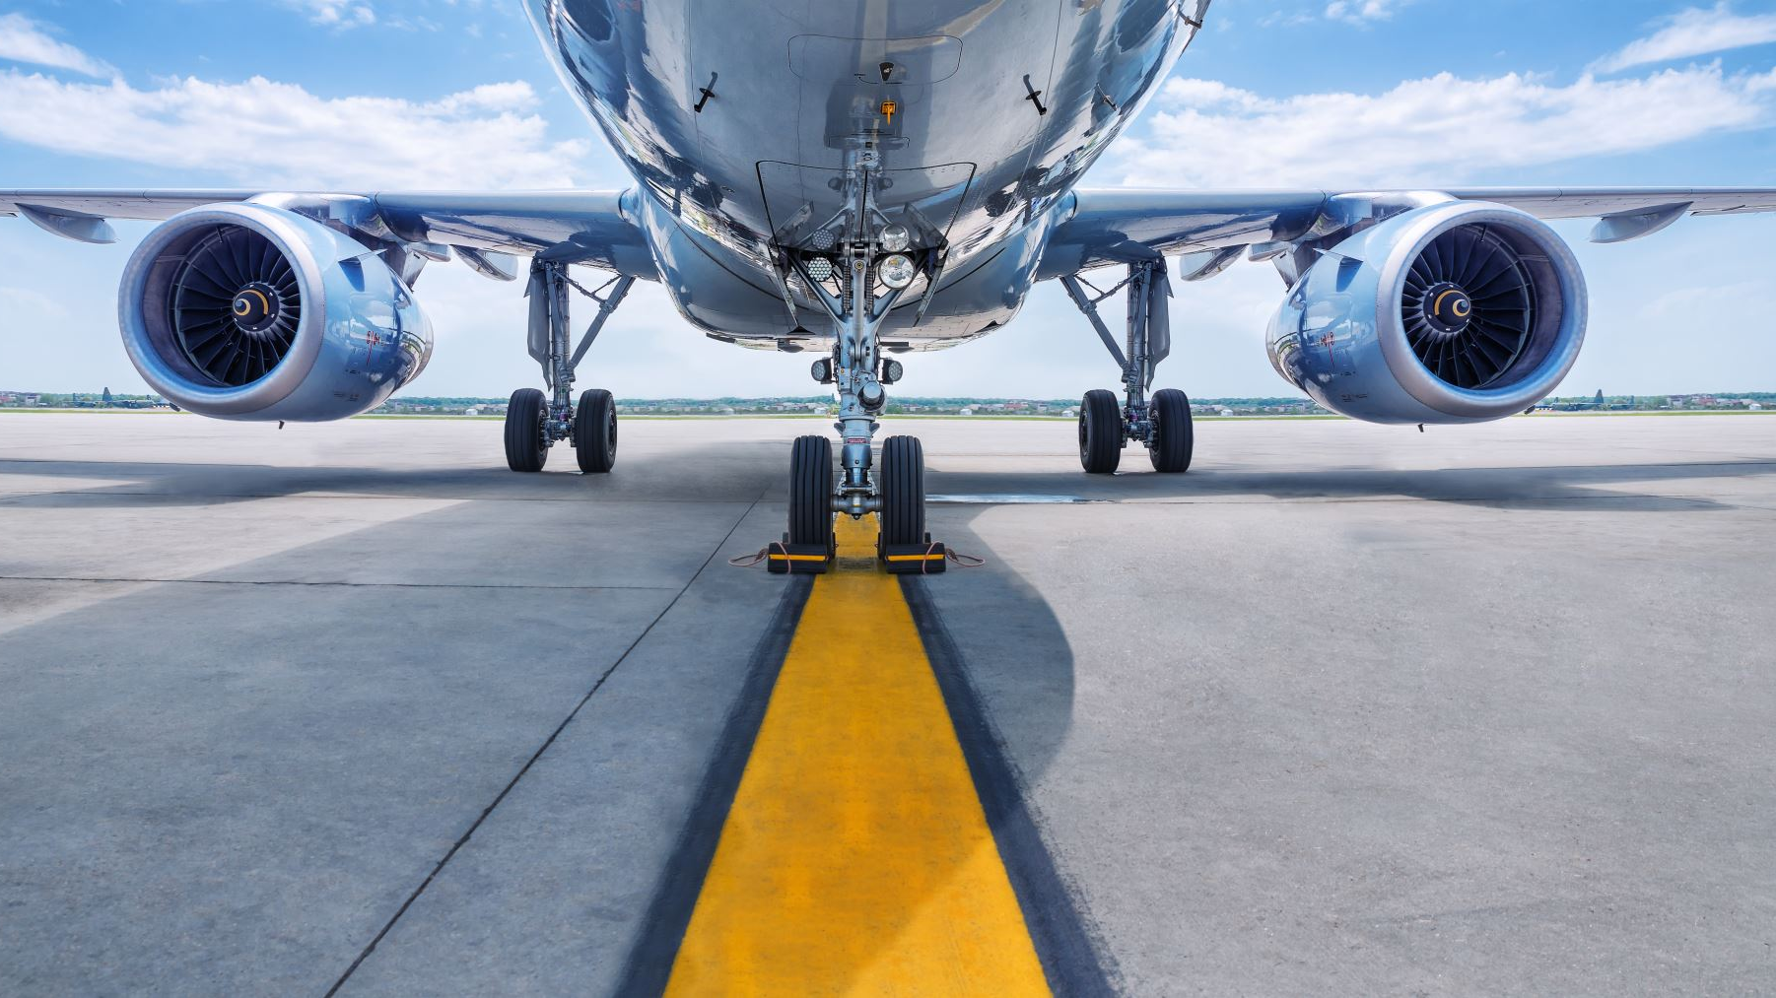
Challenge Explanation
The goal is to maximize the aircraft payload subject to multiple constraints:
PL - Payload Limits: The payload limits include conditions on the maximum capacity, the maximum allowed number of containers and their positions on the aircraft.
CL - Centre of Gravity Limits: The center of gravity of the fully loaded aircraft must be within given bounds, moreover it must approach a given target value.
SL - Shear Limits: The shear of the fully loaded

Slide 11
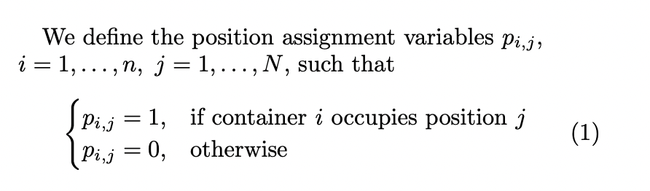
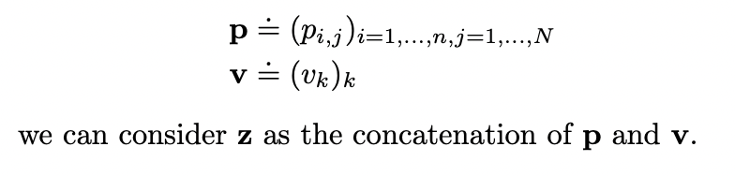
QUBO: Variables

Slide 12
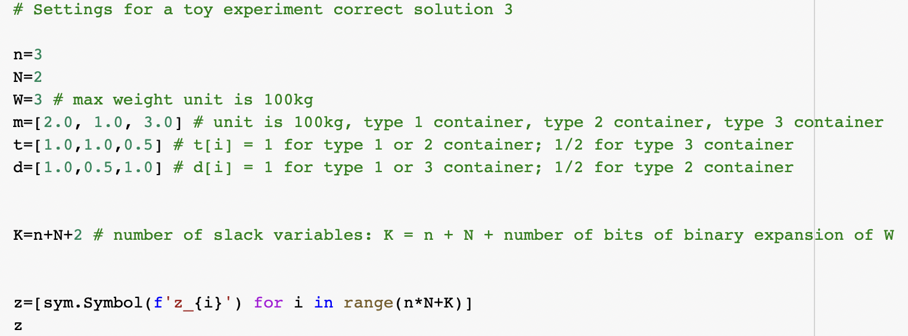

Slide 13
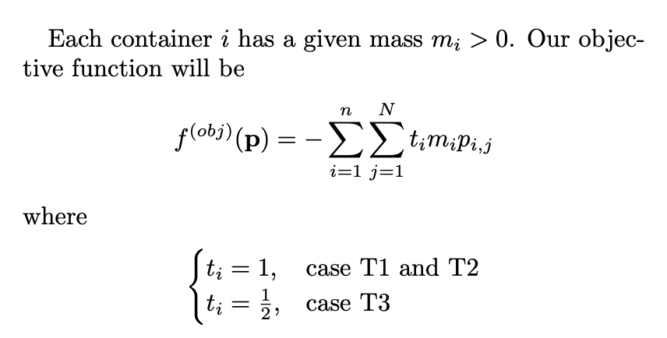
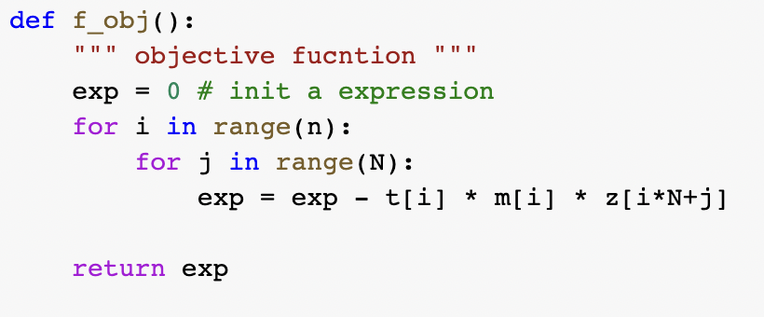
Objective Function

Slide 14
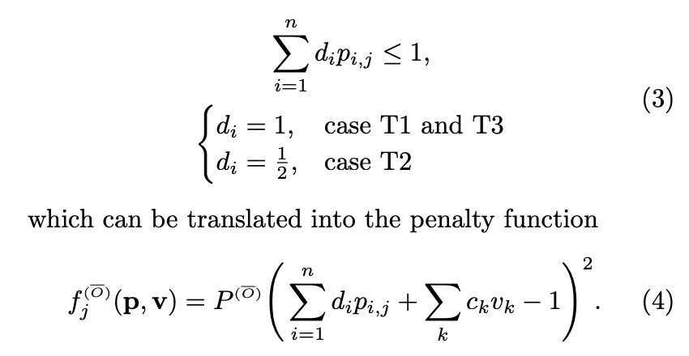
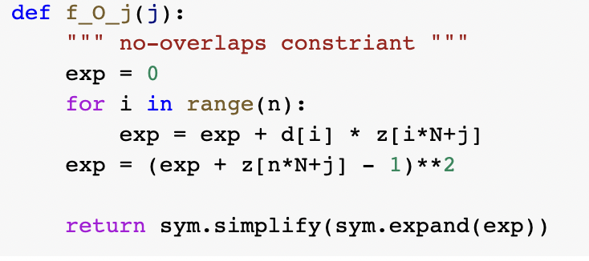
Penalty functions
Payload Limits (PL): No-overlaps

Slide 15
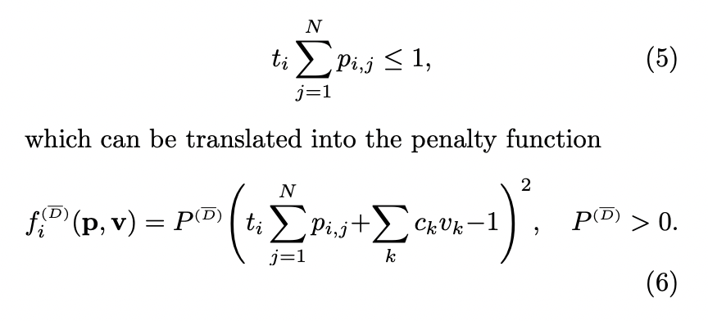
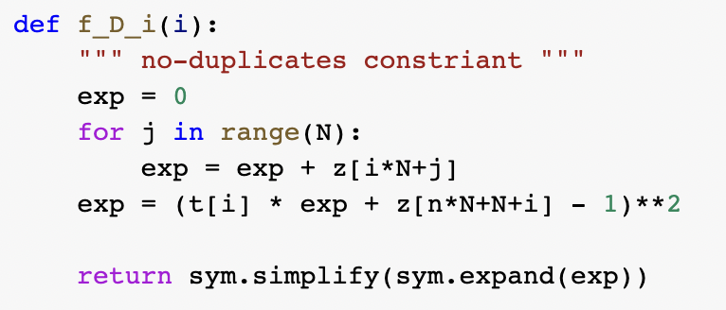
Penalty functions
Payload Limits (PL): No-duplicates

Slide 16
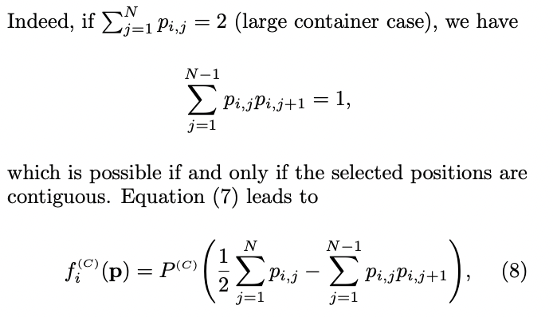
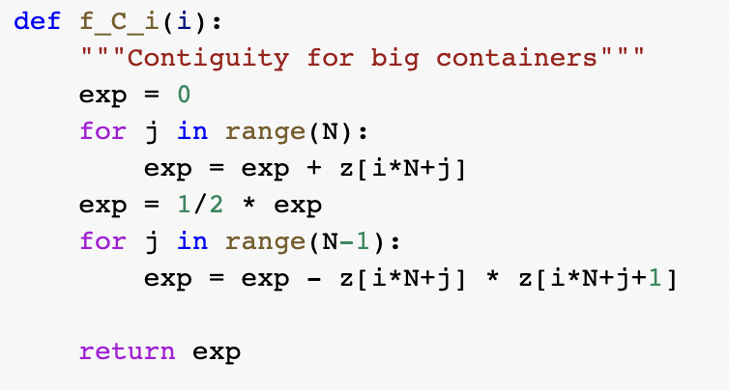
Penalty functions
Payload Limits (PL): Contiguity

Slide 17
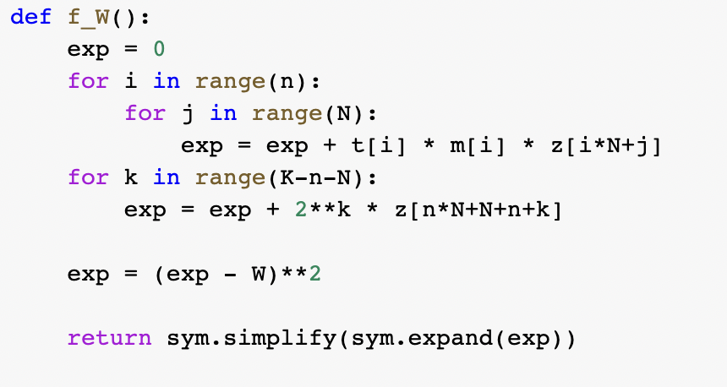
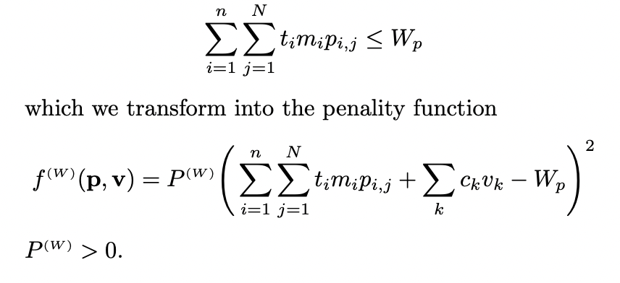
Penalty functions
Payload Limits (PL): Maximum capacity

Slide 18
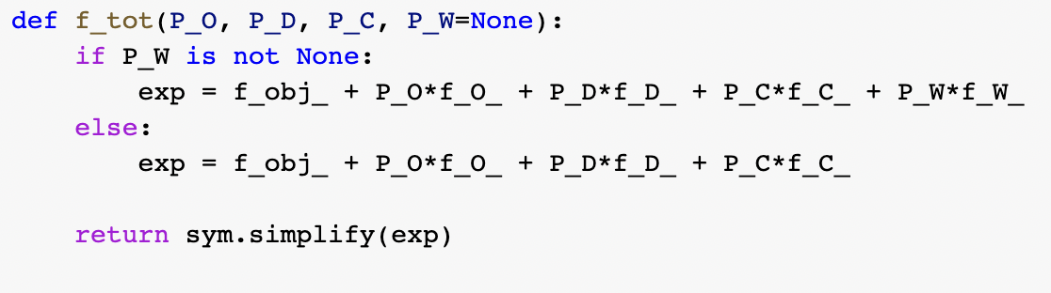
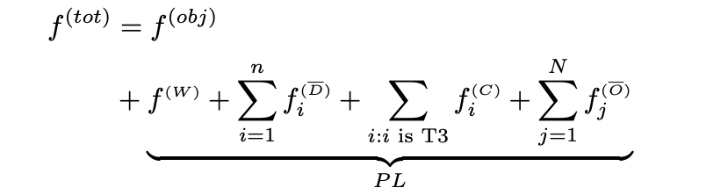
Total function
The total function is given by the sum of the object function and the penalty functions

Slide 19
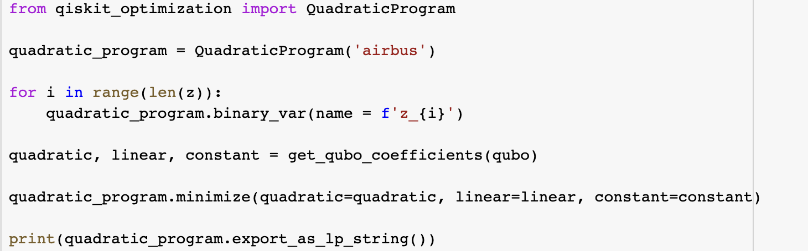
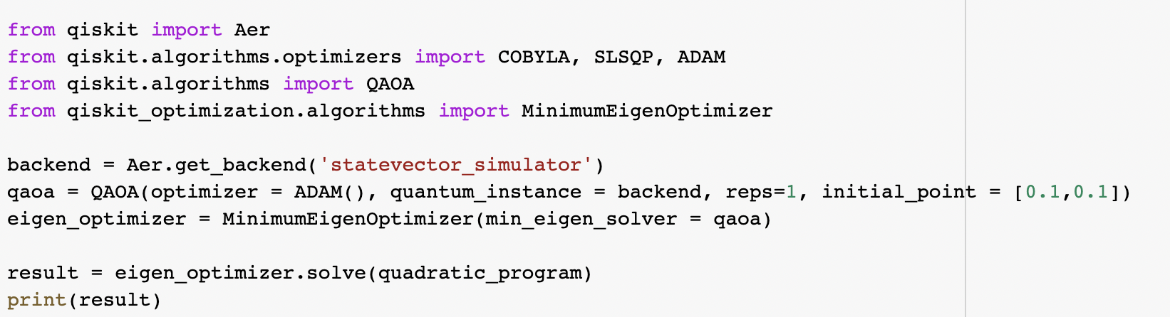
The QAOA and MinimumEigenOptimizer class
Qiskit provides its own implementation of QAOA which allows us to solve optimization problems with only a few lines of code.

Slide 20
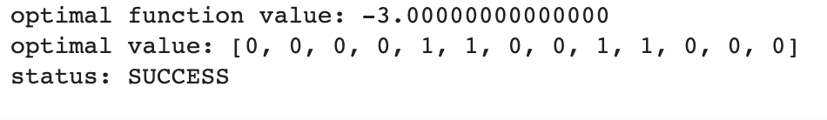
Qiskit only supports 15 qubits
A toy example solved by QAOA

Slide 21
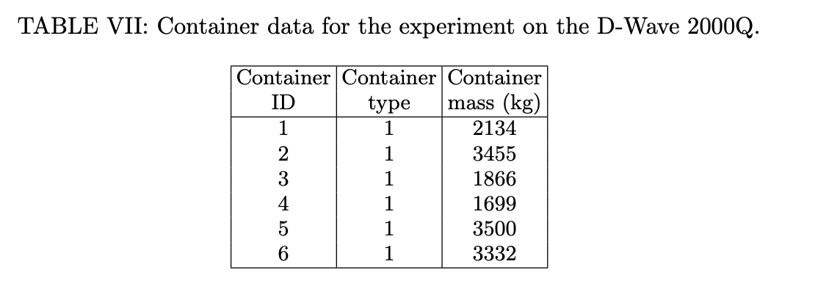
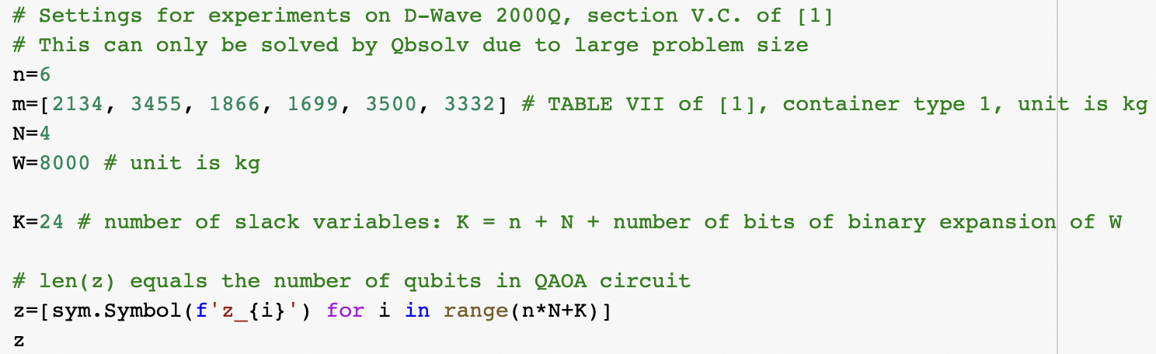
Qbsolv
A decomposing solver that finds a minimum value of a large quadratic unconstrained binary optimization (QUBO) problem by splitting it into pieces. The pieces are solved using a classical solver running the tabu algorithm. Qbsolv also enables configuring a D-Wave system as the solver.

Slide 22
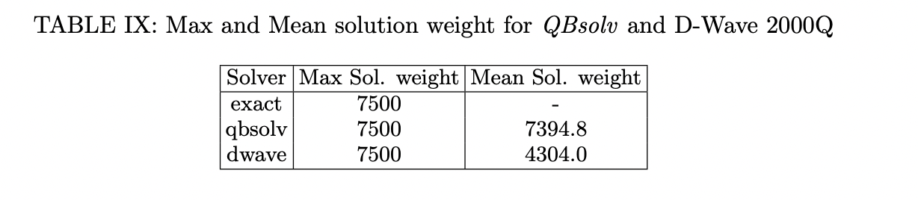
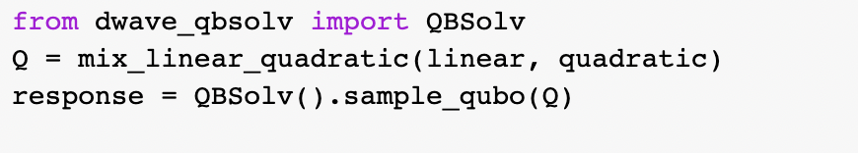
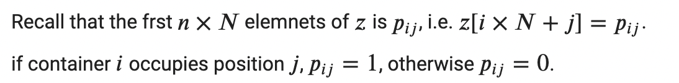
Qbsolv

Slide 23
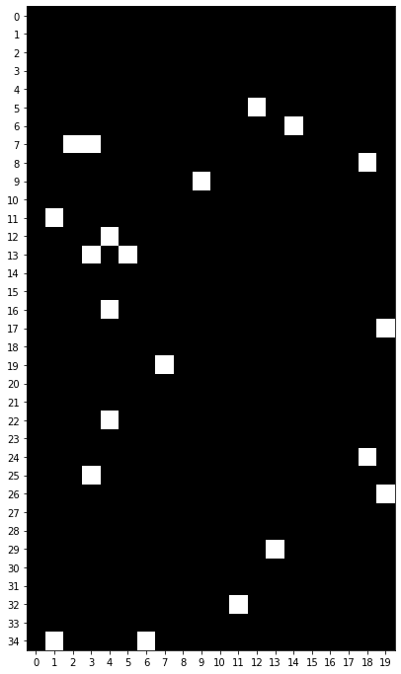
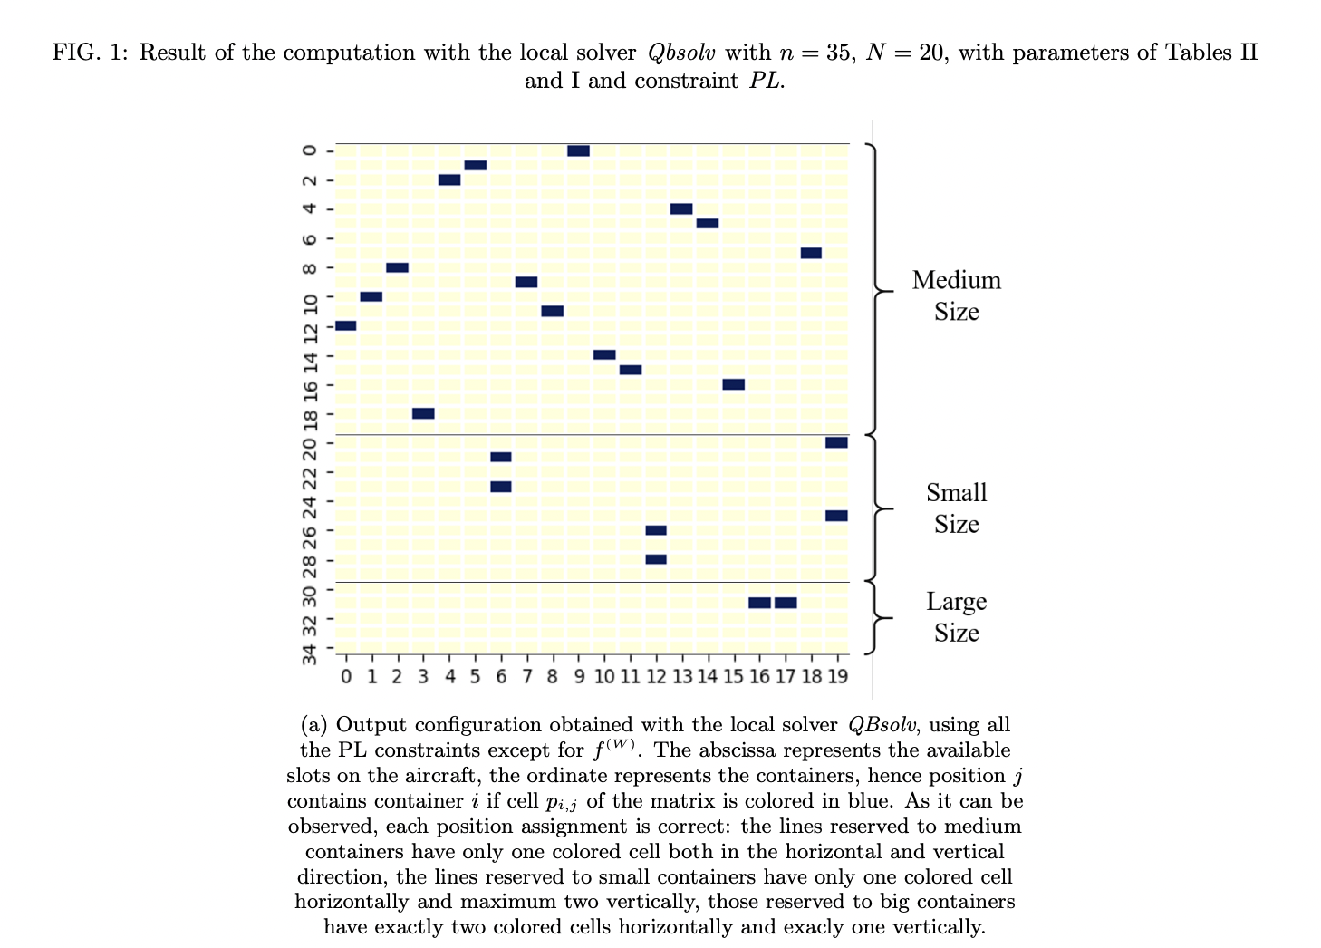
Todo:

Slide 24
Code available at
https://github.com/magelead/finq-airbus-challenge

